Slide 1
Electric vehicle charging
Bude CNA - December 2021

Slide 2
EV charging policies and projects
Decarbonising transport
Electric vehicle charging delivery plan
Off-street charging: Drive EV2 project
On-street and residential off street charging solutions
Alternative funding solutions
Cornwall Design Guide and integration of EV charging in planning policies

Slide 3
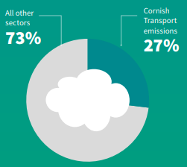
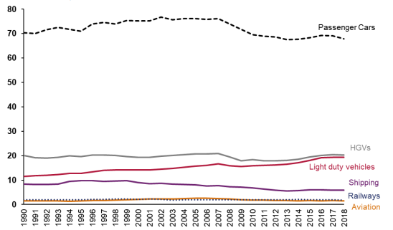
1 - Electric vehicles and decarbonising transport
Cornish emissions of carbon dioxide (MtCO2e) in 2018
Estimated emissions of carbon dioxide (MtCO2e) by transport category 1990 to 2018
Objective: Reduction of 80% from 2018 levels by 2030
We do NOT expect the transition to electric vehicles to achieve objectives alone

Slide 4
2 – EV charging delivery plan and policies
Currently ~55 charging points and half of them open to general public
EV delivery plan in draft as on-street charging policies being reviewed
Cornwall Design Guide
Peninsula Transport: EV charging and technology study
Department for Transport consulting on probable future statutory duty of local authorities to provide EV charging

Slide 5
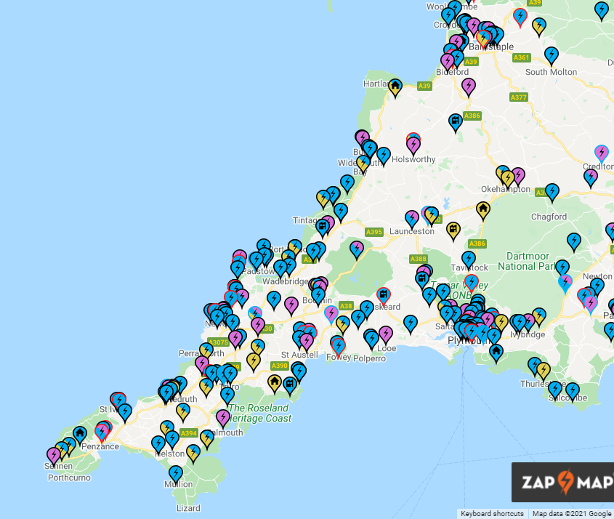
2 – EV charging delivery plan and policies
ZapMap.com
GeniePoint.co.uk

Slide 6
3 - Off-street charging: Drive EV2
£2.9M from ERDF to deliver 150+ new charging points
Drive EV2 team is in place to deliver off-street charging points
Only for public off-street car parks
Assessment of locations to prioritise delivery
Delivery by March 2023 at the latest
Other funding opportunities under review
Rapid Charging Fund to come on A roads

Slide 7
4 - On-street and private off street charging solutions
On-Street Residential Charging Scheme (ORCS): opportunities under review
Electric Vehicle Homecharge Scheme (EVHS): until April 2022, then only rentals
Workplace Charging Scheme (WCS)

Slide 8
5 - Alternative funding solutions?
Town Deals and other local funds
S106/CIL
Private investors

Slide 9
6 - Cornwall Design Guide and integration of EV charging in planning policies
Off-street and on-street parking not available for all residents.
Grouped off-street parking recommended, then on-street parking for ease of EV charging.
A gap remains for older and more constrained neighbourhoods such as terraced rows where on-street is not an option.

Slide 10
Thank you / Meur ras
If you have any questions or comments
mael.garrec@cornwall.gov.uk
Please comment on:
www.letstalk.cornwall.gov.uk/lets-talk-transport

